Slide 1
Course Information & Chapter 1
Computer Architecture

Slide 2
Course Information
§1.1 Introduction
Professor: Sanggil Kang, Ph.D.
  Office: Hi-Tech #1206,
  E-mail: sgkang@inha.ac.kr
  Phone: x-8377,
  Office hour: Wed. 14:00 ~ 16:00
  T.A : 백운영
  Office: Hi-Tech #1204
  E-mail: whitecl1031@naver.com
  Phone: x-8377
Chapter 1 — Computer Abstractions and Technology — 2

Slide 3
Course Information
§1.1 Introduction
Textbook: Computer Organization and Design MIPS Edition by David A. Patterson, Elsevier
  Grading policy
  Relative evaluation
  Mid-term exam: 30% (April 23, Tue 18:00)
  Final exam: 50% ( June 10, Mon 18:00)
  Quiz(Assignment): 10%
  Attendance: 10% (F for 8 times absence!!)
  1.25 point deduction / absence
Chapter 1 — Computer Abstractions and Technology — 3
Notes:
퀴즈 총 네 개
두개는 미리 말씀해 주심 (디자인) -> 6점
실제 퀴즈 -> 4점

Slide 4
Those who are absent at mid-term or final exam will be given an "F“
When class is canceled due to my conference participation, governmental project evaluation,
etc., I will provide a pre-recorded video lecture.
The quiz is executed at the starting time of class.
In this class, the quiz is semantically equivalent with assignment
Chapter 1 — Computer Abstractions and Technology — 4

Slide 5
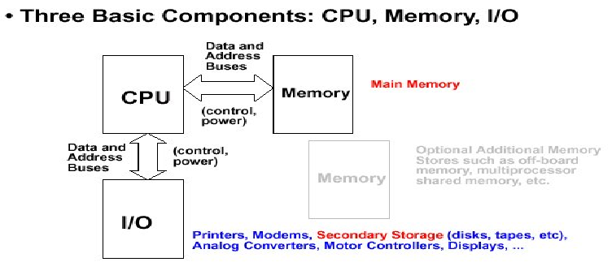
Computer Architecture
§1.1 Introduction
Chapter 1 — Computer Abstractions and Technology — 5
Notes:
2장 : 명령어 구조 -> 여기서 퀴즈 볼거임 (명령어 구조를 디자인하라)
산술, 연산 등의 명령어를 지정
3장 : ALU (Arithmetic/Logic Unit)
4장 : CPU - pipeline (파이프라인 구조 디자인 퀴즈 2)
컴퓨터 성능의 고려 사항
1. speed (컴공서 다룸) 2.power
5장 : 메모리

Slide 6
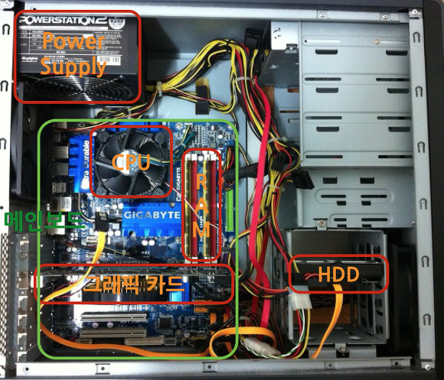
Computer Architecture
§1.1 Introduction
Chapter 1 — Computer Abstractions and Technology — 6

Slide 7
Classes of Computers
Personal computers
  General purpose, variety of software
  Subject to cost/performance tradeoff
Server computers
  Network based
  High capacity, performance, reliability
  Range from small servers to building sized
Chapter 1 — Computer Abstractions and Technology — 7
Notes:
공부 x

Slide 8
Classes of Computers
Supercomputers
  High-end scientific and engineering calculations
  Highest capability but represent a small fraction of the overall computer market
Embedded computers
  Hidden as components of systems
  Stringent power/performance/cost constraints
Chapter 1 — Computer Abstractions and Technology — 8

Slide 9
What You Will Learn
Translate programs into the machine language
  And how the hardware executes them
Machine language → Role of hardware/software interface
Program performance
  And how it can be improved
How hardware designers improve performance
Chapter 1 — Computer Abstractions and Technology — 9

Slide 10

Below Your Program
Application software
  Written in high-level language
System software
  Compiler: translates HLL code to machine code
  Operating System: service code
    Handling input/output
    Managing memory and storage
    Scheduling tasks & sharing resources
Hardware
  Processor, memory, I/O controllers
§1.3 Below Your Program
Chapter 1 — Computer Abstractions and Technology — 10

Slide 11

Levels of Program Code
High-level language
  Level of abstraction closer to problem domain
  Productivity and portability
Assembly language
  Textual representation of instructions
Hardware representation
  Binary digits (bits)
  Encoded instructions and data
Chapter 1 — Computer Abstractions and Technology — 11
Notes:
어셈블리어와 기게어는 일대일 매칭 관계
encoded = binary 화

Slide 12
Inside the Processor (CPU)
Datapath: performs operations on data
Control: sequences datapath, memory, ...
Cache memory
  Small fast SRAM memory for immediate access to data
Chapter 1 — Computer Abstractions and Technology — 12

Slide 13
Abstractions
The BIG Picture
Abstraction helps us deal with complexity
  Hide lower-level detail
Instruction set architecture (ISA)
  The hardware/software interface
Application binary interface
  The ISA plus system software interface
Implementation
  The details underlying and interface
Chapter 1 — Computer Abstractions and Technology — 13
Notes:
추상화
isa : ex) muli, add, lw ...
필요한 명령어의 개수에 따라 bit 수를 조정가능

Slide 14




A Safe Place for Data
Volatile main memory
  Loses instructions and data when power off
Non-volatile secondary memory
  Magnetic disk
  Flash memory
  Optical disk (CDROM, DVD)
Chapter 1 — Computer Abstractions and Technology — 14

Slide 15
Understanding Performance
Algorithm
  Determines number of operation steps
  Programming language, compiler, architecture
  Determine number of machine instructions executed per operation
Processor and memory system
  Determine how fast instructions are executed
I/O system (including OS)
  Determines how fast I/O operations are executed
Chapter 1 — Computer Abstractions and Technology — 15
Notes:
여기서 시험 문제 낸듯
여기서만 시험나올듯 오늘 한것중에는
1. 알고리즘 -> 사람이 똑똑함?
2. 언어별 라이브러리, SRAM(Cache) 스케쥴링, 아키텍쳐 = ISA
기계어 명령어의 숫자를 결정해줌
3. CPU가 빠르면됨 (pipeline, 코어 숫자 등), 메모리 속도
4. 하드웨어 자체가 빠르면 됨

Slide 16




Defining Performance
§1.6 Performance
Which airplane has the best performance?
Chapter 1 — Computer Abstractions and Technology — 16

Slide 17
Response Time and Throughput
Response time
  How long it takes to do a task
Throughput
  Total work done per unit time
    e.g., tasks/transactions/… per hour
How are response time and throughput affected by
  Replacing the processor with a faster version?
  Adding more processors?
We’ll focus on response time for now…
Chapter 1 — Computer Abstractions and Technology — 17
Notes:
속도를 측정하는 항목
1. 응답시간 (비행기)
2. 전체 수행시간 (기차)

Slide 18
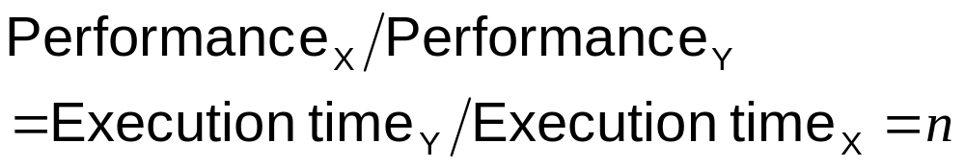
Relative Performance
Define Performance = 1/Execution Time
“X is n time faster than Y”
Example: time taken to run a program
  10s on A, 15s on B
  Execution Time_{B} / Execution Time_{A}
  = 15s / 10s = 1.5
  So A is 1.5 times faster than B
Chapter 1 — Computer Abstractions and Technology — 18

Slide 19
Measuring Execution Time
Elapsed time
  Total response time, including all aspects
    Processing, I/O, OS overhead, idle time
  Determines system performance
CPU time
  Time spent processing a given job
    Discounts I/O time, other jobs’ shares
Chapter 1 — Computer Abstractions and Technology — 19
Notes:
1주차 수업 마지막
elapsed time : 모든 구간의 시간을 다 더한거
cpu time :

Slide 20
CPU Clocking
Operation of digital hardware governed by a constant-rate clock
Clock period
Clock (cycles)
Data transfer
and computation
Update state
Clock period: duration of a clock cycle
  e.g., 250ps = 0.25ns = 250×10^{–12}s
Clock frequency (rate): cycles per second
  e.g., 4.0GHz = 4000MHz = 4.0×10⁹Hz
Chapter 1 — Computer Abstractions and Technology — 20
Notes:
cpu가 각 명령어가 실행할때 신호를 주는것 -> 일정한 신호가, 일정한 주기로 반복됨
clock 신호가 상승할때 계산시작, 메모리에서 나감
clock period 정해주는 법 (ex 3.6GHz) : 제일 시간이 많이 걸리는 명령어를 기준으로 clock 을 정해줌
-> 가장 오래 소요되는 최소 일 (명령어)을 기준으로 정함
period와 frequency는 역수관계
frequency의 단위는 Hz

Slide 21
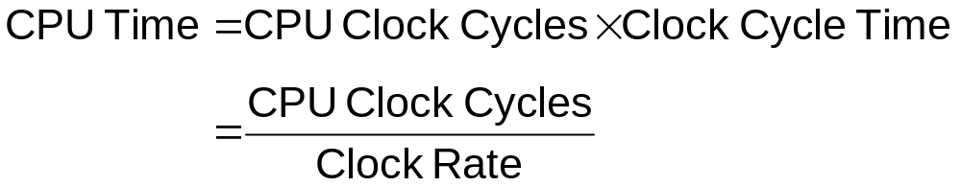
CPU Time
Performance improved by
  Reducing number of clock cycles
  Increasing clock rate
  Hardware designer must often trade off clock rate against cycle count
Chapter 1 — Computer Abstractions and Technology — 21
Notes:
cpu time = 어떤 일을 처리하는데 필요한 사이클의 개수 * 사이클 하나에 걸리는 시간
trade-off 관계임

Slide 22
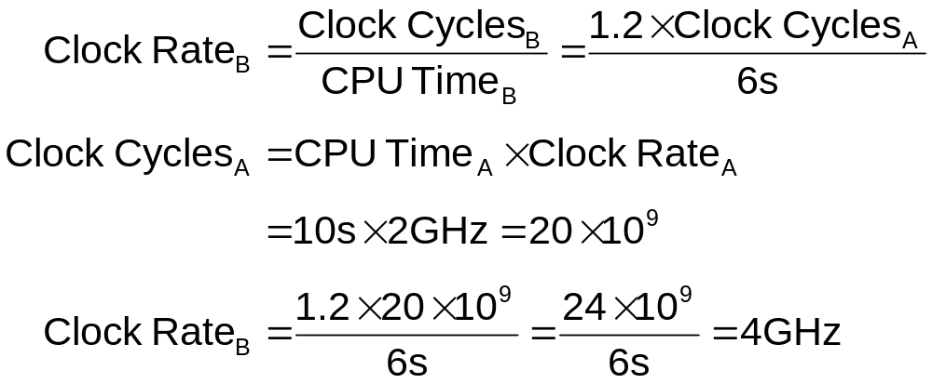
CPU Time Example
Computer A: 2GHz clock, 10s CPU time
Designing Computer B
  Aim for 6s CPU time
  Can do faster clock, but causes 1.2 × clock cycles
How fast must Computer B clock be?
Chapter 1 — Computer Abstractions and Technology — 22
Notes:
전체 cpu 시간은 40% 향상
cc는 20% 하락
clock-rate는 100% 상승

Slide 23
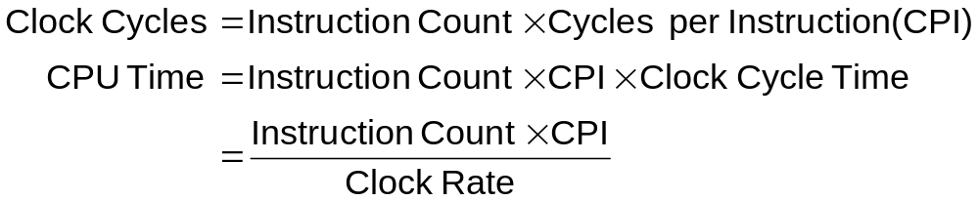
Instruction Count and CPI
Instruction Count for a program
  Determined by program, ISA and compiler
Average cycles per instruction
  Determined by CPU hardware
  If different instructions have different CPI
    Average CPI affected by instruction mix
Chapter 1 — Computer Abstractions and Technology — 23
Notes:
CC = IC * CPI
cpu time =cct * ic * cpi
ic는 어떻게 improve시킬까? -> 프로그램을 잘 짜면 됨
ISA: mips는 대부분의 명령어가 비슷한 clock 수가 걸려, intel은 아냐
compiler : 컴파일러마다 달라
이전시험 : cputime(IC)을 줄이기 위한 노력, 퍼포먼스에 영향을 끼치는 요소
CPI 도 ISA와 관련이 있음
하드웨어 구조랑도 관련이 있음 : ex 동시성

Slide 24

CPI Example
Computer A: Cycle Time = 250ps, CPI = 2.0
Computer B: Cycle Time = 500ps, CPI = 1.2
Same ISA
Which is faster, and by how much?
A is faster…
…by this much
Chapter 1 — Computer Abstractions and Technology — 24
Notes:
same isa = ic가 같다

Slide 25
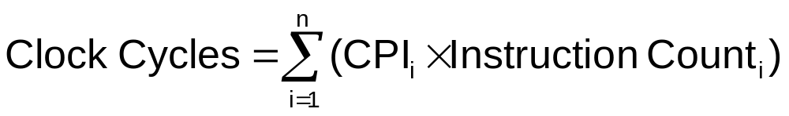

CPI in More Detail
If different instruction classes take different numbers of cycles
Weighted average CPI
Relative frequency
Chapter 1 — Computer Abstractions and Technology — 25

Slide 26
CPI Example
Alternative compiled code sequences using instructions in classes A, B, C
Class | A | B | C
CPI for class | 1 | 2 | 3
IC in sequence 1 | 2 | 1 | 2
IC in sequence 2 | 4 | 1 | 1
Sequence 1: IC = 5
  Clock Cycles
  = 2×1 + 1×2 + 2×3
  = 10
  Avg. CPI = 10/5 = 2.0
Sequence 2: IC = 6
  Clock Cycles
  = 4×1 + 1×2 + 1×3
  = 9
  Avg. CPI = 9/6 = 1.5
Chapter 1 — Computer Abstractions and Technology — 26
Notes:
명령어 수는 20% 많은데도
평균 cpi는 25%줄임

Slide 27
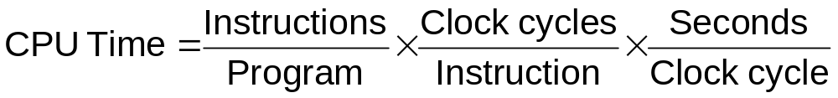
Performance Summary
The BIG Picture
Performance depends on
  Algorithm: affects IC, possibly CPI
  Programming language: affects IC, CPI
  Compiler: affects IC, CPI
  Instruction set architecture: affects IC, CPI, T_{c}
Chapter 1 — Computer Abstractions and Technology — 27
Notes:
Tc = CCT

Slide 28

Power Trends
§1.7 The Power Wall
In CMOS IC technology
×30
5V → 1V
×1000
Chapter 1 — Computer Abstractions and Technology — 28
Notes:
시험 X

Slide 29

Uniprocessor Performance
§1.8 The Sea Change: The Switch to Multiprocessors
Constrained by power, instruction-level parallelism, memory latency
Chapter 1 — Computer Abstractions and Technology — 29
Notes:
거의 한계에 부딪힘
memory latency가 중요

Slide 30
Multiprocessors
Multicore microprocessors
  More than one processor per chip
Requires explicitly parallel programming
  Compare with instruction level parallelism
    Hardware executes multiple instructions at once
    Hidden from the programmer
  Hard to do
    Programming for performance
    Load balancing
    Optimizing communication and synchronization
Chapter 1 — Computer Abstractions and Technology — 30

Slide 31

SPEC CPU Benchmark
Programs used to measure performance
  Supposedly typical of actual workload
Standard Performance Evaluation Corp (SPEC)
  Develops benchmarks for CPU, I/O, Web, …
SPEC CPU2006
  Elapsed time to execute a selection of programs
    Negligible I/O, so focuses on CPU performance
  Normalize relative to reference machine
  Summarize as geometric mean of performance ratios
    CINT2006 (integer) and CFP2006 (floating-point)
Chapter 1 — Computer Abstractions and Technology — 31

Slide 32
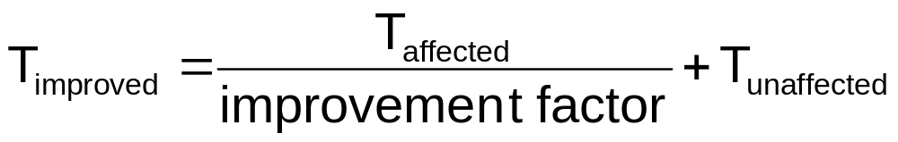
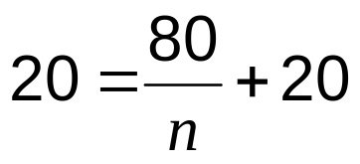
Pitfall: Amdahl’s Law
Improving an aspect of a computer and expecting a proportional improvement in overall performance
§1.10 Fallacies and Pitfalls
Example: multiply accounts for 80s/100s
  How much improvement in multiply performance to get 5× overall?
  Can’t be done!
Corollary: make the common case fast !!
Chapter 1 — Computer Abstractions and Technology — 32
Notes:
모든 개발에 똑같이 적용되는 이야기
메모리 접근시간이 100배 차이가나면 메모리 접근 시간을 줄여야돼
많이 사용하는 애를 빠르게 해

Slide 33

Pitfall: MIPS as a Performance Metric
MIPS: Millions of Instructions Per Second
  Doesn’t account for
    Differences in ISAs between computers
    Differences in complexity between instructions
  CPI varies between programs on a given CPU
Chapter 1 — Computer Abstractions and Technology — 33

Slide 34
Concluding Remarks
Cost/performance is improving
  Due to underlying technology development
Hierarchical layers of abstraction
  In both hardware and software
Instruction set architecture
  The hardware/software interface
Execution time: the best performance measure
Power is a limiting factor
  Use parallelism to improve performance
§1.9 Concluding Remarks
Chapter 1 — Computer Abstractions and Technology — 34
Notes:
X
뒷부분 x표시 말고는 다 읽어봐

